Slide 1
Tuple

Slide 2
Tuple
Tuples are used to store multiple items in a single variable.
Tuple is one of 4 built-in data types in Python used to store collections of data, the other 3 are List , Set , and Dictionary , all with different qualities and usage.
A tuple is a collection which is ordered and unchangeable.
Tuples are written with round brackets.
Example:ur own Python Server
Create a Tuple:
thistuple = ("apple", "banana", "cherry") print(thistuple)

Slide 3
Tuple Items:
Tuple items are ordered, unchangeable, and allow duplicate values.
Tuple items are indexed, the first item has index [0], the second item has index [1] etc.
properties of tuples
Ordered:
When we say that tuples are ordered, it means that the items have a defined order, and that order will not change.
Unchangeable
Tuples are unchangeable, meaning that we cannot change, add or remove items after the tuple has been created.
Immutable: This means once we create a tuple, we cannot change it.
Non homogenous: This means that not all the elements in the tuple have to be of the same type. For example, We can have a tuple in which some elements are numbers and some are strings
Allow Duplicates
Since tuples are indexed, they can have items with the same value:
Example: Tuples allow duplicate values:
thistuple = ("apple", "banana", "cherry", "apple", "cherry") print(thistuple)

Slide 4
Tuple Length
Example
Print the number of items in the tuple:
thistuple = ("apple", "banana", "cherry")
print(len(thistuple))
Create Tuple With One Item
Example
One item tuple, remember the comma:
thistuple = ("apple",)
print(type(thistuple))
#NOT a tuple
thistuple = ("apple")
print(type(thistuple))

Slide 5
Tuple Items - Data Types
Tuple items can be of any data type:
Example
String, int and boolean data types:
tuple1 = ("apple", "banana", "cherry") tuple2 = (1, 5, 7, 9, 3) tuple3 = (True, False, False)
A tuple can contain different data types:tuple1 = ("abc", 34, True, 40, "male")
type(): mytuple = ("apple", "banana", "cherry") print(type(mytuple))
Python Collections (Arrays)
There are four collection data types in the Python programming language:
List is a collection which is ordered and changeable. Allows duplicate members.
Tuple is a collection which is ordered and unchangeable. Allows duplicate members.
Set is a collection which is unordered, unchangeable*, and unindexed. No duplicate members.
Dictionary is a collection which is ordered** and changeable. No duplicate members.

Slide 6
Access Tuple Items
You can access tuple items by referring to the index number, inside square brackets:
Example: Print the second item in the tuple:
thistuple = ("apple", "banana", "cherry") print(thistuple[1])
Negative Indexing
Negative indexing means start from the end.
-1 refers to the last item, -2 refers to the second last item etc.
Example: Print the last item of the tuple:
thistuple = ("apple", "banana", "cherry") print(thistuple[-1])
Range of Indexes:You can specify a range of indexes by specifying where to start and where to end the range.When specifying a range, the return value will be a new tuple with the specified items.
Example: Return the third, fourth, and fifth item:
thistuple = ("apple", "banana", "cherry", "orange", "kiwi", "melon", "mango") print(thistuple[2:5])
print(thistuple[:4])
print(thistuple[2:])
print(thistuple[-4:-1]) #This example returns the items from index -4 (included) to index -1 (excluded)
Check if Item Exists
thistuple = ("apple", "banana", "cherry") if "apple" in thistuple: print("Yes, 'apple' is in the fruits tuple")

Slide 7
Update Tuples
Tuples are unchangeable, meaning that you cannot change, add, or remove items once the tuple is created.
But there are some workarounds. You can convert the tuple into a list, change the list, and convert the list back into a tuple.
x = ("apple", "banana", "cherry") y = list(x) y[1] = "kiwi" x = tuple(y) print(x)
Add Items
Since tuples are immutable, they do not have a built-in append() method, but there are other ways to add items to a tuple.
Example
Convert the tuple into a list, add "orange", and convert it back into a tuple:
thistuple = ("apple", "banana", "cherry") y = list(thistuple) y.append("orange") thistuple = tuple(y)
# Following action is not valid for tuples
# tup1[0] = 100;

Slide 8
Contn…
Add tuple to a tuple. You are allowed to add tuples to tuples, so if you want to add one item, (or many), create a new tuple with the item(s), and add it to the existing tuple:
Example
Create a new tuple with the value "orange", and add that tuple:
thistuple = ("apple", "banana", "cherry") y = ("orange",) thistuple += y print(thistuple)

Slide 9
Unpacking a Tuple When we create a tuple, we normally assign values to it. This is called "packing" a tuple:
Example: Packing a tuple
fruits = ("apple", "banana", "cherry")
But, in Python, we are also allowed to extract the values back into variables. This is called "unpacking":
Example : Unpacking a tuple:
fruits = ("apple", "banana", "cherry") (green, yellow, red) = fruits print(green) print(yellow) print(red)

Slide 10
Python - Loop Tuples:
You can loop through the tuple items by using a for loop.
Iterate through the items and print the values:
thistuple = ("apple", "banana", "cherry") for x in thistuple: print(x)
Loop Through the Index Numbers
thistuple = ("apple", "banana", "cherry") for i in range(len(thistuple)): print(thistuple[i])

Slide 11
Join:Join two tuples:
tuple1 = ("a", "b" , "c") tuple2 = (1, 2, 3) tuple3 = tuple1 + tuple2 print(tuple3)
Multiply Tuples:
fruits = ("apple", "banana", "cherry") mytuple = fruits * 2 print(mytuple)

Slide 12
Tuple Methods Python has two built-in methods that you can use on tuples.
Method | Description
count() | Returns the number of times a specified value occurs in a tuple
index() | Searches the tuple for a specified value and returns the position of where it was found
Count method
Example
Return the number of times the value 5 appears in the tuple:
thistuple = (1, 3, 7, 8, 7, 5, 4, 6, 8, 5) x = thistuple.count(5) print(x)
index() Method
Search for the first occurrence of the value 8, and return its position:
thistuple = (1, 3, 7, 8, 7, 5, 4, 6, 8, 5) x = thistuple.index(8) print(x)

Slide 13
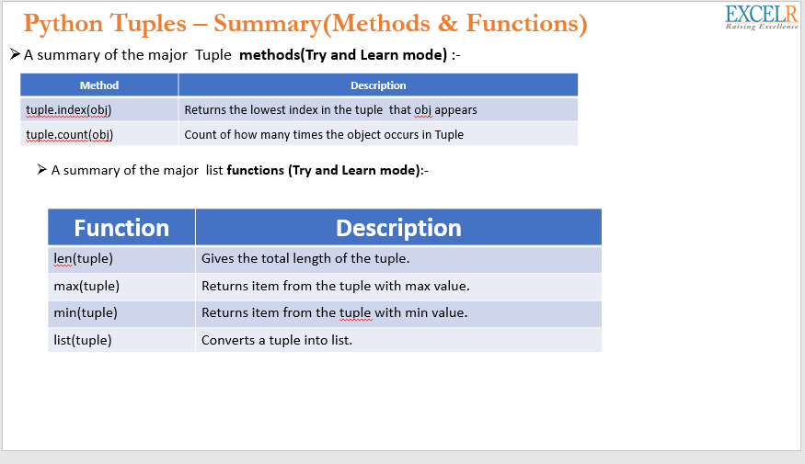

Slide 14
Exercise 1: Reverse the tuple
Exercise 2: Swap two tuples in Python
Exercise 3: Write a program to copy elements 44 and 55 from the following tuple into a new tuple.
tuple1 = (11, 22, 33, 44, 55, 66)
https://pynative.com/python-tuple-exercise-with-solutions/#h-exercise-5-swap-two-tuples-in-python
https://csiplearninghub.com/important-tuple-questions-in-python/

Slide 15
1)tuple1 = (10, 20, 30, 40, 50)
tuple1 = tuple1[::-1]
print(tuple1)
2) tuple1 = (11, 22)
tuple2 = (99, 88)
tuple1, tuple2 = tuple2, tuple1
print(tuple2)
print(tuple1)
3) tuple1 = (11, 22, 33, 44, 55, 66)
tuple2 = tuple1[3:-1]
print(tuple2)

Slide 16
Stimulants
1. What is the output of the following snippet of code?
T1=4,5,6
print(type(T1))
2. What is the output of the following snippet of code?
T1=(1,2,3,4,5,6,7,8)
print(T1)
print(T1*2)
print(T1+T1)
print(len(T1)*2)
3. What is the output of the following snippet of code?
T1=(1,2,3,4,5,6,7,8)
print(T1[0])
print(T1[-1])
print(T1[2+3])
print(T1[4-1])
print(T1[7%2])

Slide 17
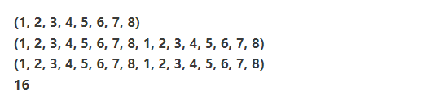
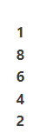
Ans 1: <class tuple>
Ans 2:
Ans 3:

